Slide 1



PROJECT PLANNER WITH AI
Presented By,
Shrihari J (811722104147)
Thishal M (811722104169)
Vishwas S (811722104187)
Amudheeswaran S (811722104301)
Guided By,
Mr. M.Saravanan, M.E.,
DD/MM/YYYY

Slide 2

ABSTRACT
Project Planner with AI revolutionizes the way people and teams manage projects by incorporating state-of-the-art artificial intelligence in planning.
This system simplifies managing a project, indicating tasks, estimating resource use, and tracking progress in real-time.
The planner is made to be flexible according to its users' needs and provides optimized schedules that align with personal workflows.
DD/MM/YYYY

Slide 3


OBJECTIVE
Save time and effort for individuals and teams in planning and managing projects.
.Simplify interaction between users and the AI system for a seamless project management experience.
Ensure easy access to project-related information and updates.
Minimize the time required to create, adjust, and track project progress.

Slide 4
LITERATURE SURVEY
S.No. | Paper Title | Year | Remark
1 | AI-Driven Project Planning Tools | 2023 | Enhances algorithms in the form of machine learning and natural language processing
2 | Personalization in Planning with Artificial Intelligence | 2023 | significance of personalization in AI-driven project planners.
3 | Efficient Budget and Resource Allocation in Projects Using AI | 2023 | investigates the role of AI in optimizing budget and resource allocation
DD/MM/YYYY

Slide 5
LITERATURE SURVEY
S.No. | Paper Title | Year | Remark
4 | Real-Time Collaboration and Progress Tracking in Projects | 2023 | explores the integration of real-time data synchronization and progress tracking
5 | A Survey on Chatbot Implementation in Customer Service Industry through Deep Neural Networks | 2023 | reviews the use of AI chatbots in the customer service sector
6 | A Survey on Chatbot Implementation in Education Sector | 2023 | explores the application of chatbots in educational settings
DD/MM/YYYY

Slide 6
LITERATURE SURVEY
S.No. | Paper Title | Year | Remark
7 | Building Chatbots with Machine Learning and NLP | 2024 | in-depth analysis of how machine learning and NLP are used
8 | A Survey of Chatbot Systems through a Loebner Prize Perspective | 2024 | survey covers pattern-matching techniques, AIML, and NLP frameworks
9 | An Overview of Chatbot Technology | 2024 | evolution of chatbot systems from early rule-based models to modern AI-powered ones
DD/MM/YYYY

Slide 7
EXISTING SYSTEM
Existing solutions rarely offer real-time troubleshooting or adaptive suggestions when users face challenges during project execution.
Most existing systems lack the ability to tailor project suggestions, timelines, and material requirements to individual user preferences and constraints, such as budget, available tools, and skill level.
Many platforms provide generalized estimates for materials, leading to overspending or shortages. A precise calculation based on project specifics is often missing.
DD/MM/YYYY

Slide 8
PROPOSED SYSTEM
Users can input specific queries, such as asking for project ideas within a budget, skill level, or specific material. The system processes the input and provides tailored responses.
The admin can remove outdated or irrelevant projects from the system to maintain a high- quality library of resources.
Based on the user’s input query, the system provides relevant DIY project examples, helping users identify suitable projects to start with.
DD/MM/YYYY

Slide 9
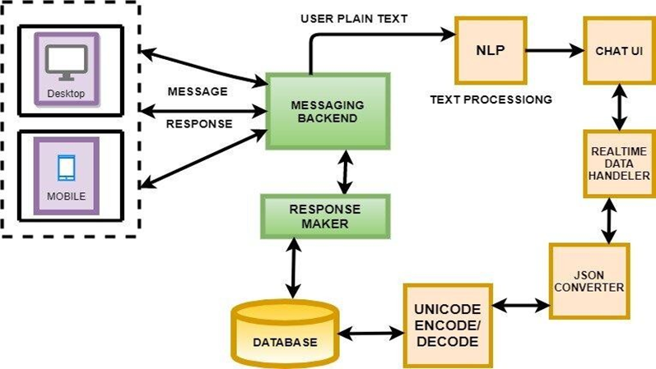
SYSTEM ARCHITECTURE
DD/MM/YYYY

Slide 10
MODULE 1 : User Management
The User Management Module is a core component of the Project Planner with ChatBit, designed to provide a secure, personalized, and role-aware experience for all users.
. It manages the complete lifecycle of user interaction, starting from registration and authentication to profile customization and access control.
The module supports full profile management, allowing users to update personal details, change passwords, configure privacy settings, and manage notifications.
DD/MM/YYYY

Slide 11
MODULE 2 : Project Planning
. Users can initiate a new project by inputting fundamental details such as the project name, description, estimated difficulty level, duration, and expected outcome.
Each project can be broken down into a series of customizable steps, where users can specify detailed instructions, tools, materials, estimated cost, and time required for completion.
A real-time auto-save function ensures no progress is lost, even in the event of disconnection or browser closure
DD/MM/YYYY

Slide 12
MODULE 3 : ChatBit
The ChatBit AI Assistant is a cornerstone feature of the Project Planner platform, designed to deliver an intelligent, personalized, and highly interactive user experience through advanced Natural Language Processing (NLP) and contextual awareness.
Users can interact with ChatBit using natural, conversational language—whether via typing or voice—enabling a smooth and intuitive communication flow.
In case of user hesitation or confusion, ChatBit can proactively offer clarifying questions or suggest the next logical step, keeping the user focused and motivated.
DD/MM/YYYY

Slide 13
MODULE 4 : Material Management
. The Material Management Module is an essential component of the DIY Project Planner with ChatBit, meticulously designed to streamline the tracking, organization, and acquisition of tools and materials required for successful project execution.
. It provides users with a centralized interface where they can create and manage a comprehensive inventory for each DIY project, listing out all necessary materials, quantities, units, and associated tools.
To improve planning accuracy and reduce manual effort, the module includes auto- suggestion features that can recommend commonly used tools.
DD/MM/YYYY

Slide 14
MODULE 5 : Data Storage
. The Data Storage Module is a foundational backend component of the DIY Project Planner with ChatBit, tasked with securely storing, managing, and analyzing all forms of user-generated and system-generated data within the platform.
To ensure high availability and fault tolerance, the system supports automated backups, replication, and disaster recovery strategies, providing data resilience and minimizing the risk of data loss.
DD/MM/YYYY

Slide 15

OUTPUT
DD/MM/YYYY

Slide 16
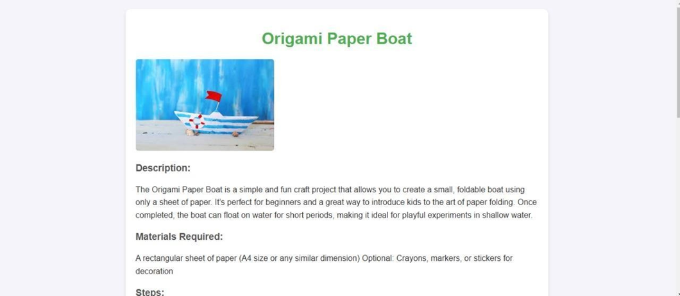
OUTPUT
DD/MM/YYYY

Slide 17
CONCLUSION & FUTURE ENHANCEMENT
. By integrating AI-powered tools into a Project Planner, we have developed a system that simplifies project planning, resource management, and task allocation
This project leverages machine learning algorithms to provide intelligent recommendations tailored to the user's project type and requirements.
The project has a wide scope in the current context, with most proposed features successfully implemented.Future work will involve creating a centralized database to store extracted data for better management
DD/MM/YYYY

Slide 18
REFERENCES
1. E. Brown, R. Kapoor, and M. Lopez, Proceedings of the 2023 International Conference on Artificial Intelligence in Personal Applications (ICAIPA 2023), 2023.
2.S. Lee, M. Johnson, A. Mehta, and O. Turner, Proceedings of the 2023 IEEE Symposium on Human-Centric AI Systems (HCAIS 2023), 2023.
3.P. Sharma, A. Khan, C. Rivera, and E. Zhang, "Efficient Budget and Resource Allocation in DIY Projects Using AI, (CROAI 2023), 2023.
DD/MM/YYYY

Slide 19

DD/MM/YYYY

